Slide 1
Technical Writing: Brochures
Week 7, Chapter 7

Slide 2
What is a Brochure?
One of the most popular marketing tools
Helps draw the attention of prospective customers
Can be distributed manually, via mail or email
or placed in brochure racks
Printed on a single tri-fold sheet of thick glossy paper
Includes pictures, photos, and other graphics

Slide 3
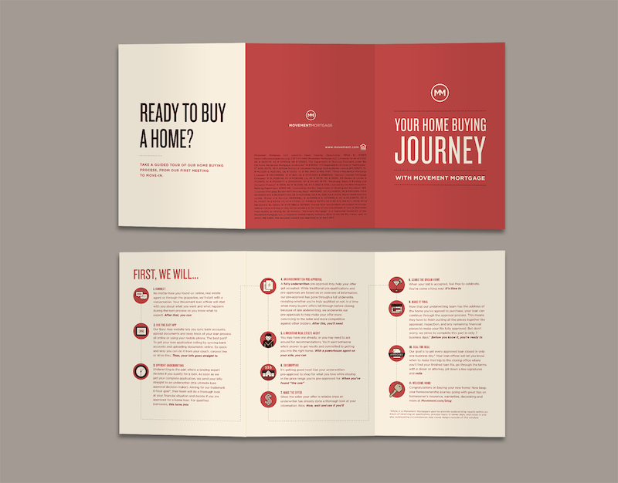
Example of a Brochure

Slide 4
Steps for Writing a Brochure
Determine the audience for your message.
Your brochure may be directed toward specific groups such as potential clients, funders, the media, or a broad audience.
Decide on the purpose of your brochure.
persuading, informing, entertaining, etc.

Slide 5
Steps for Writing a Brochure Cont.
Think about the message you want to convey to your readers.
Since a brochure format sets a strict limit to the amount of printed information, you must choose carefully among the facts, pictures, and other data you want to include.
Write the text for your brochure.
Try to be concise and accurate. The text should be written in short sentences with positive language and active voice.

Slide 6
Steps for Writing a Brochure Cont.
Decide on what graphics you are going to use to enhance the brochure.
Colorful, bright paper attracts attention and is more interesting to read. On the other hand, too many pictures or colors can distract your readers from perceiving your message, or make the brochure look too flashy.
Add a call to action at the end of your brochure.
You can ask your readers to make a phone call, visit a website for more details, or purchase a sample of your product.

Slide 7
Steps for Writing a Brochure Cont.
Proofread and edit the brochure.
Check to see if you can supersede some elements with others, or where you can use more precise words or more expressive pictures.

Slide 8
Criteria for Brochures: Title Page (Front Panel)
Topic: In the top one-third of the panel, name the topic about which you’re writing (product name, service, etc.).
Graphic: In the middle third of the panel, include a graphic to appeal to your reader’s need for a visual representation of your topic. The graphic will sell the value of your subject (its beauty, its usefulness, its location, its significance, etc.) or visually represent the focus of your brochure.
Contact Information: place contact information on the bottom third of this panel. You could include your name, your company’s name, street address, city, state, zip code, telephone number, fax number, and/or e-mail address.

Slide 9
Criteria for Brochures: Body Panels (Fold-in and Inside)
Provide headings and subheadings.
Use graphics (photos, maps, line drawings, tables, figures, etc.).
Develop your ideas. Consider including the following information, dependent upon your topic:
  —Locations, maps, directions
  —Technical Specifications and warranties
—Prices and payment plans
—Credentials and company history

Slide 10
Criteria for Brochures: Body Panels (Fold-in and Inside) Cont.
— Unique Characteristics of the product or service
—Personnel biographies and employment opportunities
—Options
—Delivery (Dates/Methods)

Slide 11
Criteria for Brochures: Back Panel
Conclusion: Use this panel to summarize your brochure’s content, highlighting your topic’s benefits, or suggesting a next step for your readers to pursue.
Mailing: This panel could be used as the face of an envelope. On this panel, when left blank, you could provide your address, a place for a stamp or paid postage, and your reader’s address.
Location: Provide your address, hours of operation, phone numbers, e-mail, and a map to help them locate you.

Slide 12
Topic Selection (Common Purposes of Brochures)
answering frequently-asked-questions
offering brief “how-to” information
showing the pros or cons
explaining a procedure to a reader
giving potential clients an overview of a company’s portfolio
encouraging a client to purchase a particular product instead of another

Slide 13
Key Points to Consider
Pay attention to how the cover of your brochure looks and what information it contains.
You are free to experiment with different shapes and designs to find a solution that matches the goal you are pursuing.
The use of testimonials in the brochure can increase its credibility in the readers’ eyes.
Brochures add credibility to your company.

Slide 14
Dos of Brochure Writing
Do write in short sentences.
Do use bulleted lists when possible.
Do try to make your brochure as helpful as possible.
Do leave some space, free from any text or graphics
in your brochure. This is called “white space.
Do only use quality paper, like glossy thick paper.
Do keep it relatively simple. Using too many fonts and bold lettering, tilt, and color will make your brochure look unprofessional.

Slide 15
Don’ts of Brochure Writing
Don’t create a complicated design. In most cases, a simple design is more efficient and easier to perceive.
Don’t write in passive voice.
Don’t combine colors just because you like them. Use colors that are complimentary or even the same as on your company’s logo.
Don’t try to cram all the information you can onto a single sheet of paper.
Don’t make your brochure too thick. It won’t make it look more solid—instead, it will chase customers away.
Don’t forget to add contact information at the end of the brochure.

Slide 16
Common Mistakes When Writing a Brochure
Printing a black and white brochure because it is cheaper.
Ignoring the importance of “white space.”
Including too much information or too many design elements.
Using stock images. Your brochure should be unique
and use custom illustrations, not generic ones.

Slide 17
Activity: Brochures
Instructions: Look at the sample brochure and then design your own product brochure keeping in mind these three aspects:
What is this product? What would you like to call it? And what will it do?
What are the three significant benefits that people will get out of its function?
What would you like people to remember about it?
(Include a picture of the product.)

Slide 18
References
https://extensionpublications.unl.edu/assets/pdf/g2028.pdf
https://www.corpwriting.com/Brochure-Content-Writing/

